Slide 1
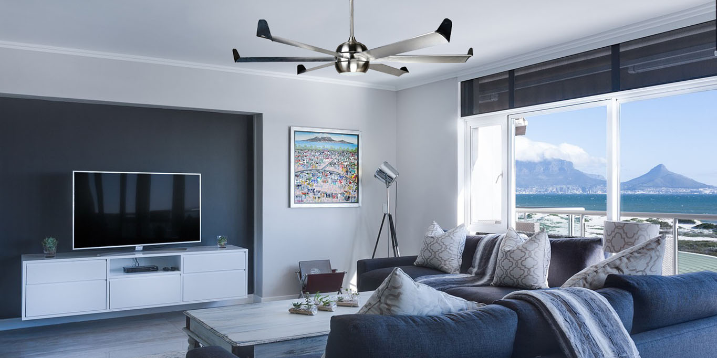
WELCOME
To E-Project Presentation

Slide 2
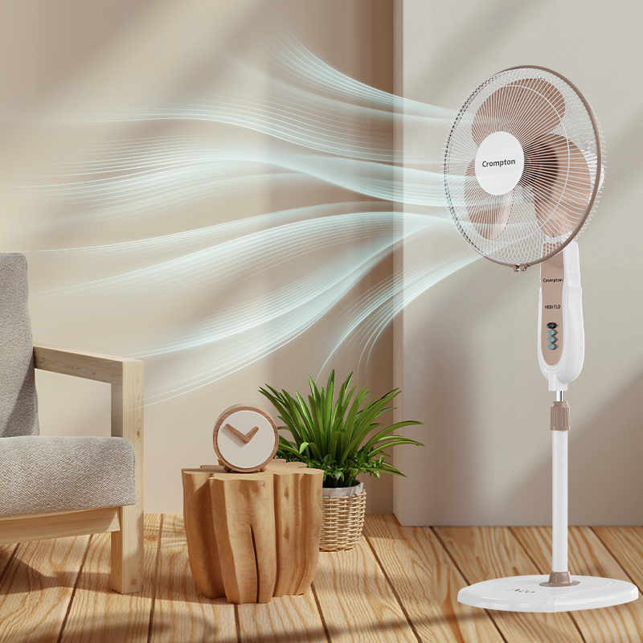

FANoFAN
Supervisor Name:
Sir Usama Riaz
Co-ordinator Name:
Miss Munazza

Slide 3
E-Project
FANoFAN Presentators
Maheen Sherazi
Student Id : 1530873
Hafza Gul
Student Id : 1530874
Noor Bibi
Student Id : 1530871
Ansa Sherazi
Student Id : 1530872

Slide 4
2
3
1
Objective
Problem Statement
Introduction
4
5
co
Requirement Specification
Conclusion

Slide 5
INTRODUCTION
FANoFAN!
At FANoFAN, we specialize in providing a diverse selection of high-quality electric fans designed to meet all your cooling needs. Our range includes stylish ceiling fans, convenient table fans, efficient exhaust fans, versatile bracket fans, and advanced inverter fans. We also offer remote-controlled fans and energy-saving models to ensure maximum comfort and efficiency. Explore FANoFAN today and discover the perfect fan that combines performance, elegance, and innovative technology for your home or office.

Slide 6
OBJECTIVE

